Slide 1
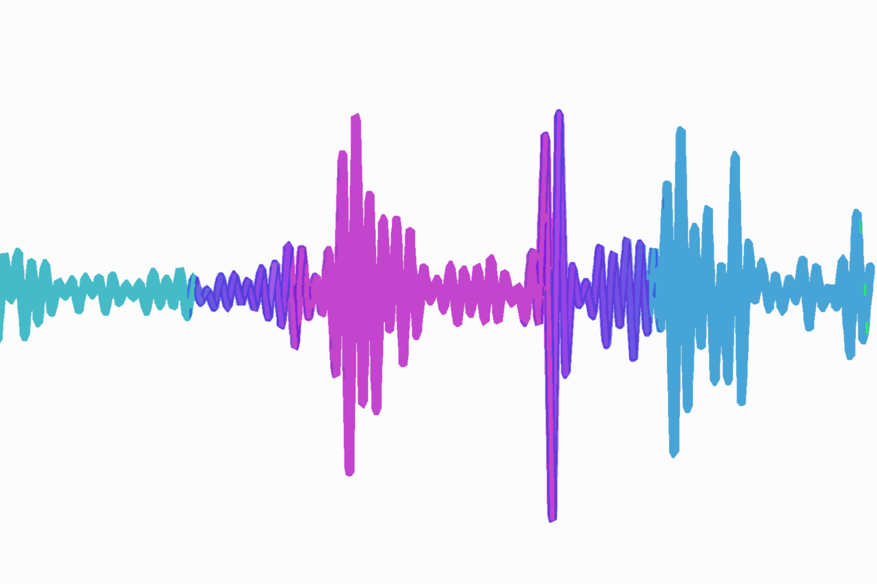
Audio synthesis Literature Review
Naman Goel Bachelor's of technology in mathematics and computing Indian institute of technology Delhi, India

Slide 2
Introduction
Currently, the multi-modal models that are available can only generate a video (without audio) from a natural language prompt. The aim of the project is to develop a deep learning model that is capable of generating video with audio given a user prompt.
Since, there already exist video generating models, the main emphasis is to be able to generate a synchronized audio that can then be layered with the video.
Importance: "Integrating high-quality audio with video enhances realism and immersion in AI-generated content."

Slide 3
Approach
Since there has been tremendous development in LLMs over the past few years, my approach to the problem is to generate human speech in the video from the transcript generated using an LLM for the video using text-to-speech technology and combine it with environmental sounds of the surrounding space to generate the required audio.
Although this limits the prompts that the model would be able to accept, it still encompasses a wide variety of possibilities and remains an equally difficult problem.

Slide 4

Text-to-speech synthesis

Slide 5
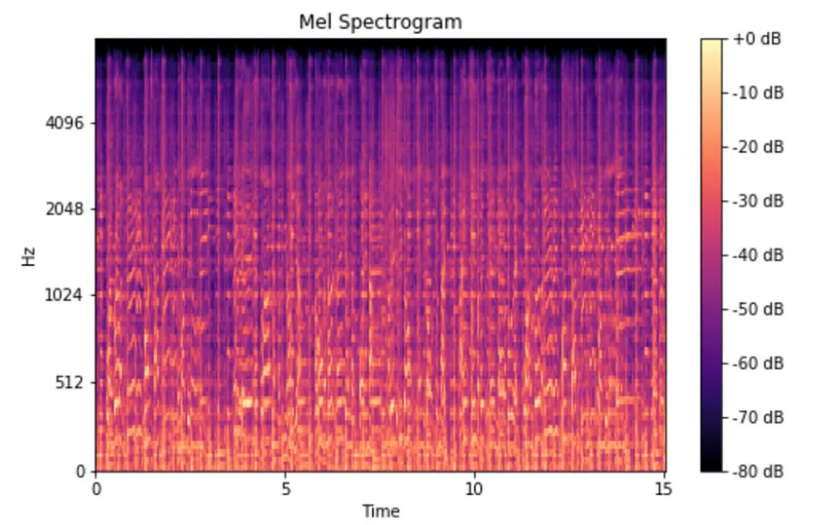
HOW it works?
TTS models have two components. The first component takes the text input and conditions on it to generate a mel-spectrogram. FastSpeech, TacoTron, Glow-TTS, etc. perform this action.
A Mel Spectrogram makes two important changes relative to a regular Spectrogram that plots Frequency vs Time. It uses the Mel Scale instead of Frequency on the y-axis. It uses the Decibel Scale instead of Amplitude to indicate colors.
The second component is called a vocoder which is used to generate the final audio waveform from the mel-spectrogram. This action is performed by models like WaveNet, WaveGlow, etc.
The output can be additionally made more realistic by making use of voice cloning with pre stored speaker embeddings for different speakers in the conversation.

Slide 6
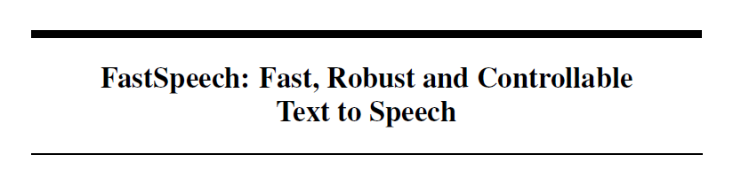
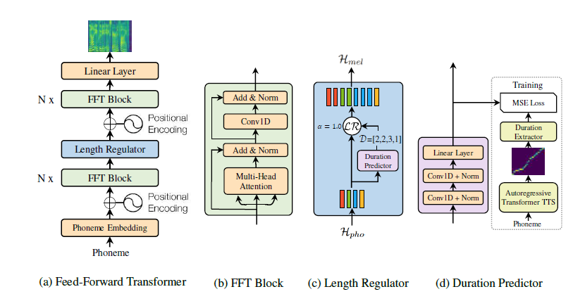
Published: 20 Nov 2019
Dataset Used: LJSpeech
Training: 80k steps on 4 NVIDIA V100 GPUs
Open-source: Yes

Slide 7
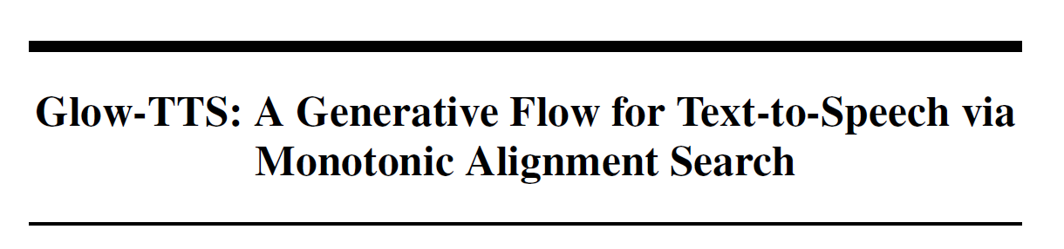
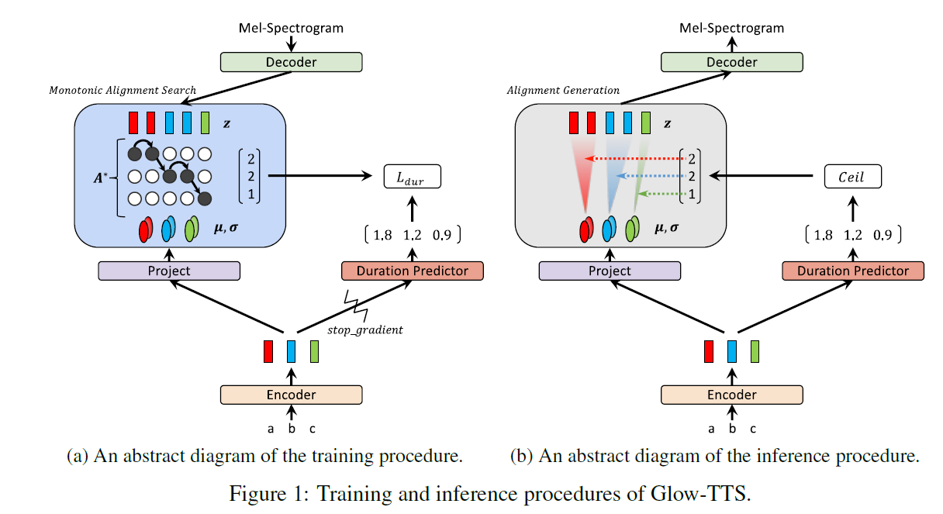
Published: 23 Oct 2020
Dataset Used: LJSpeech, LibriTTS
Training: 240k steps on 2 NVIDIA V100 GPUs (3 days)
Open-source: Yes https://github.com/jaywalnut310/glow-tts

Slide 8
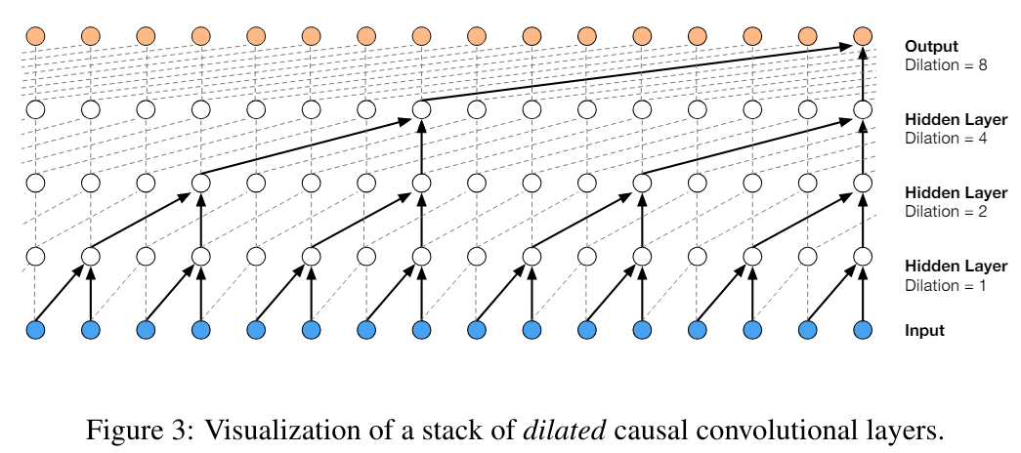
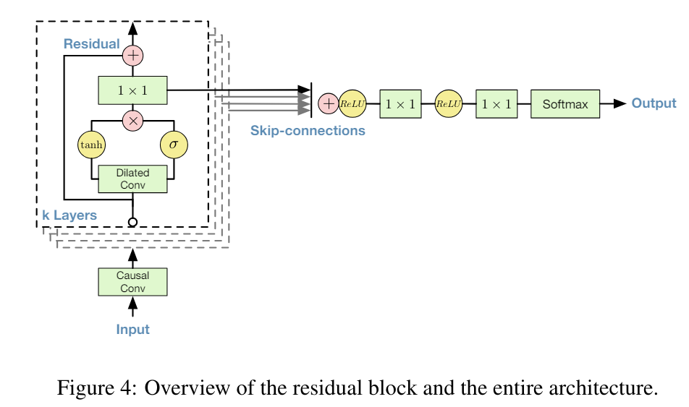
Published: 19 Sept 2016
Dataset Used: CSTR voice cloning toolkit
Training: Not mentioned in the paper
Open-source: Yes https://github.com/r9y9/wavenet_vocoder

Slide 9
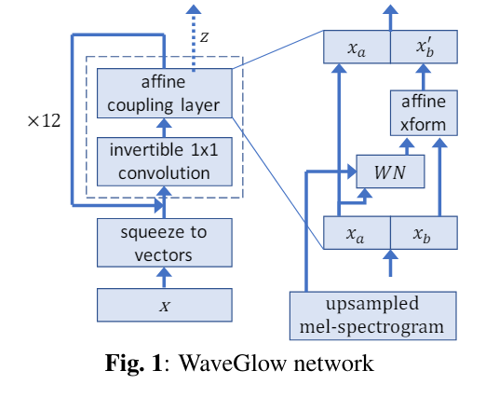
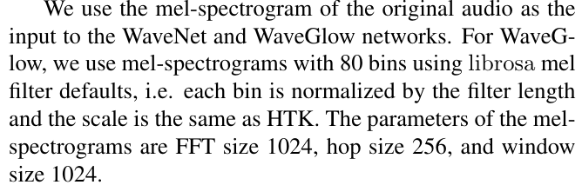
Published: 31 Oct 2018
Dataset Used: LJSpeech
Training: Not mentioned in the paper
Synthesis Time: 10 seconds utterance at 520kHz on NVIDIA V100 GPU
Open-source: Yes https://github.com/NVIDIA/waveglow

Slide 10

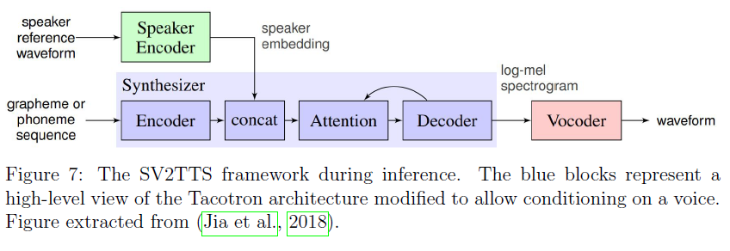
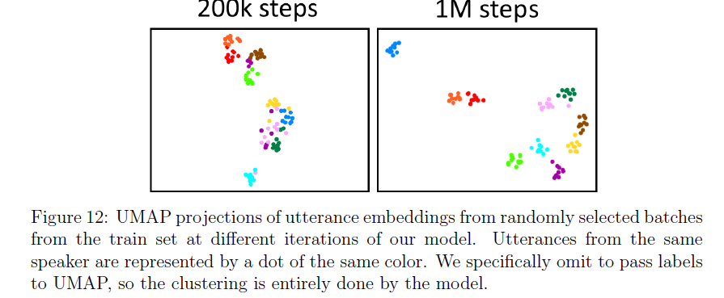
Year: 2019
Open-source: Yes
https://github.com/CorentinJ/Real-Time-Voice-Cloning

Slide 11
Environmental sounds/Acoustic scene generation

Slide 12
expectations
Keyword Extraction: Extracting relevant keywords from user prompts to identify necessary environmental sounds.
Pretrained Models: Using models trained on various acoustic scenes to generate appropriate sounds.
Combining Sounds: Integrating environmental sounds with synthesized speech for a cohesive audio experience.

Slide 13
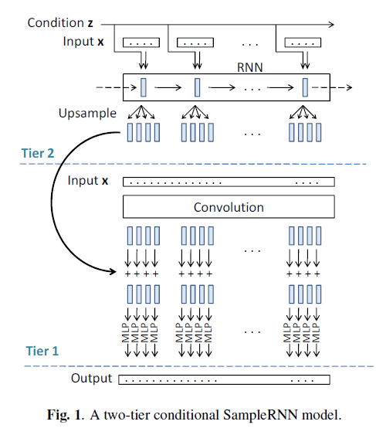
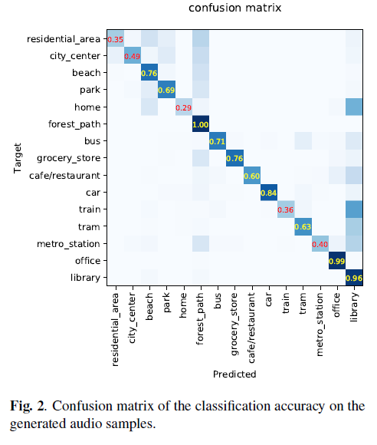
Published: 17 April 2019
Dataset Used: DCASE 2016 Task 1
Training: 240k steps on TITAN XP single-GPU card (2 days)
Open-source: Yes https://github.com/qiuqiangkong/sampleRNN_acoustic_scene_generation

Slide 14
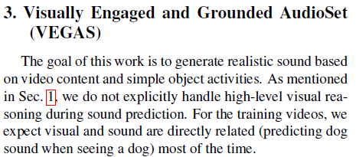
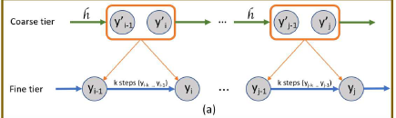
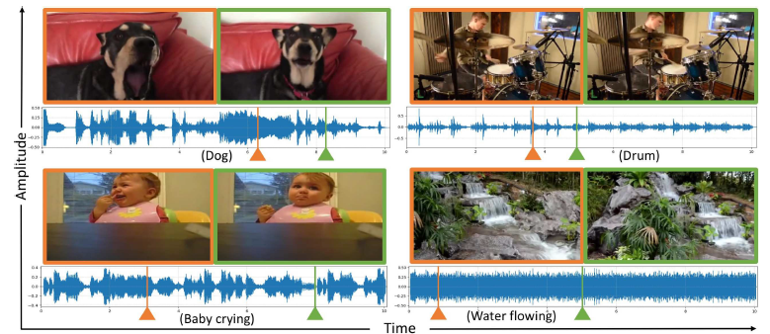

Slide 15
Acoustic analysis of 3d space

Slide 16
What it is?
Acoustic analysis of a 3D space or environment means collecting data about reverberation time, clarity, sound transmission index, definition and other acoustic factors.
This data can later be used to recreate the environment for experiments to mimic similar acoustic conditions or make a recording actually recorded somewhere else to sound like it was recorded in that desired 3D space.
Dimensions of the room are calculated to determine the fundamental harmonics corresponding to each direction (principal axes in case of a rectangular room with parallel walls and ceilings). Also recording of a range of frequencies emitted by a speaker are recorded from a mic to calculate other acoustic factors.
Online resources such as www.amacoustic.com and CATT-acoustic help in these calculations and generating acoustic models of the desired space.

Slide 17
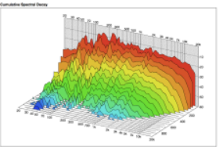
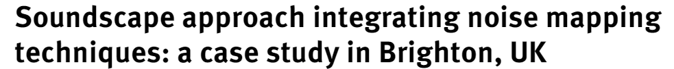
Related Resources
https://antonsoundwave.wordpress.com/2014/06/30/acoustics-room-analysis-recreation-of-room-reverb-sound-june-2014/ It explains the entire process how a sound captured in some other surrounding can be modified so that it sounds as if it was captured in the desired setting
Soundwalk: A soundwalk is a walk with a focus on listening to the environment.
Soundscape: How a sonic environment is perceived by an individual/society; appropriateness of the acoustic environment with respect to the context
Waterfall Analysis after gathering acoustic data
Noise Mapping
A database of acoustic recordings of several environments/spaces that can be potentially used in our project

Slide 18
Work on?
Areas where further research is needed:
Merging speech, environmental sounds, and acoustical features.
Technical difficulties and solutions for seamless integration. Finding more resources for this so the final output with layering of sounds doesn’t sound artificial.
Potential future advancements:
Spatialization of sound to make the experience more immersive. For now, it is assumed that the user simply plays the video/audio on PC, without headphones and so spatialization doesn’t add much to the output and only increases the complexity of the project.

Slide 19
Thank you

